Slide 1


Video Games and their Trends
By Sindy Saintclair

Slide 2
Objectives
This presentation will divulge into four major points:
How video game sales have been trending over time
The most popular genre of video game
A comparison of video game platforms by genre
A visual looking at only games by Nintendo
All of this is done to ensure that you as a company have all the information pertinent for your success in knowing how to improve your sales by knowing which games are selling, and which aren’t.

Slide 3
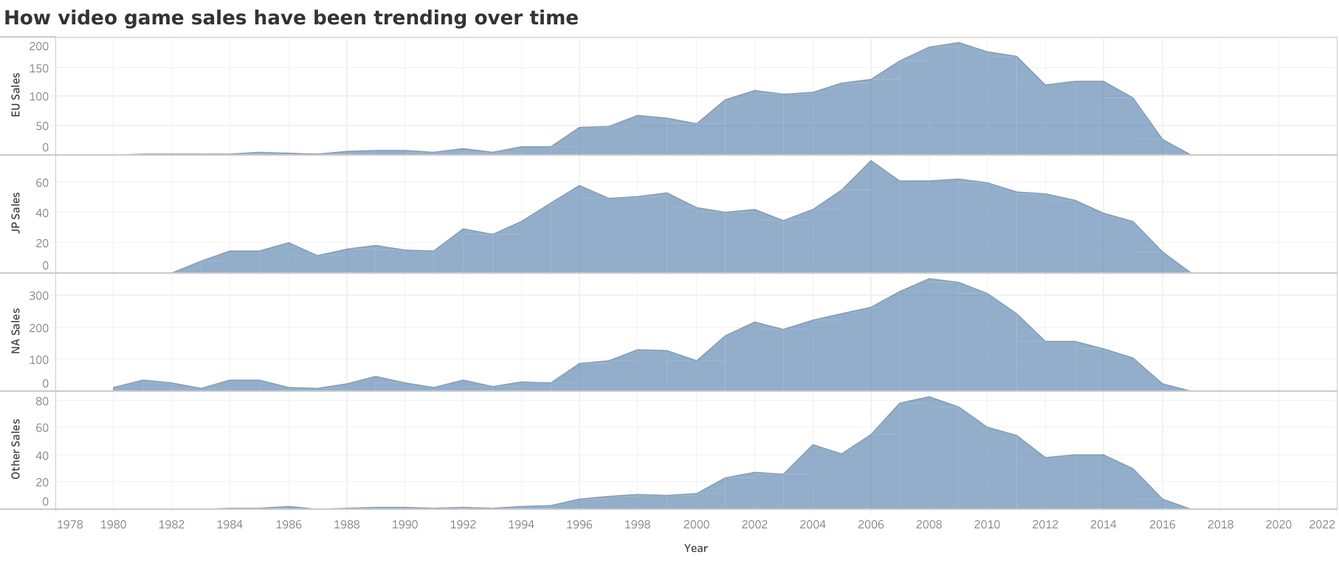
How video games sales have been trending over time
According to this graph, Europe sales of video games peaked in 2009 at 191.6 million while in Japan video games sales peaked in 2006 at 73.73 million, and North American video game sales peaked around 2008 at 351.4 million. Other areas in the world had video games sales peak in the year 2008 at 83.29 million sales.

Slide 4

Chart Analysis
In all regions where data of video games sales were collected, it was found that most regions’ sales peaked around the late 2000s, just before the end of the first decade of the 21st century. Soon after then, video games sales began to steadily decrease until 2017, which one can assume is where the data collection for video game sales ended, as people are still buying and enjoying video games to this day.

Slide 5
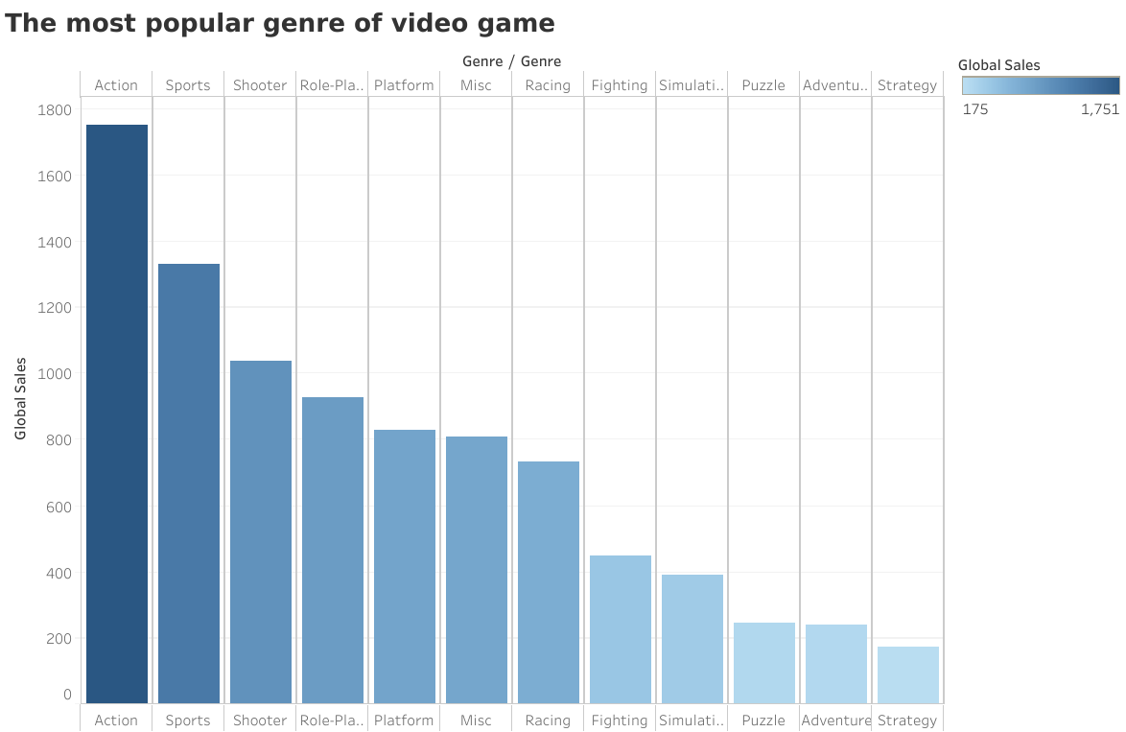
The Most Popular Genre of Video Game
If one were to examine closely, it is quite apparent that the Action genre is the most popular genre of video games, amassing nearly 1.8 billion global sales, with strategy being the least popular at just under 200 million global sales. The darker the color, the more popular the video game.

Slide 6
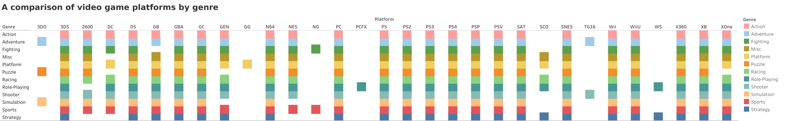
A comparison of video game platforms by genre…
As you can see, most of the platforms available carry multiple if not all genres, except for 3DO, GG, NG, PCFX, SCD, TG16, WS.
3DO only has Adventure, Puzzle, and Platform video games; GG has only Platform games; NG has fighting, and sports video games; PCFX has role-playing, SCD has Miscellaneous, Platform, Racing, Role-playing, and strategy games, TG16

Slide 7

Chart Analysis
Since action is the most popular video game genre, it would be wise to release an action genre video game on platforms that can support it such as 3DS, 2600, DC, DS, GB, GBA, GC, GEN, N64, NES, PC, PS, PS2, PS3, PS4, PSP.
It’d be best to avoid platforms that do not support action genre video games such as 3DO, GG, NG, PCFX, SCD, TG16, WS.

Slide 8
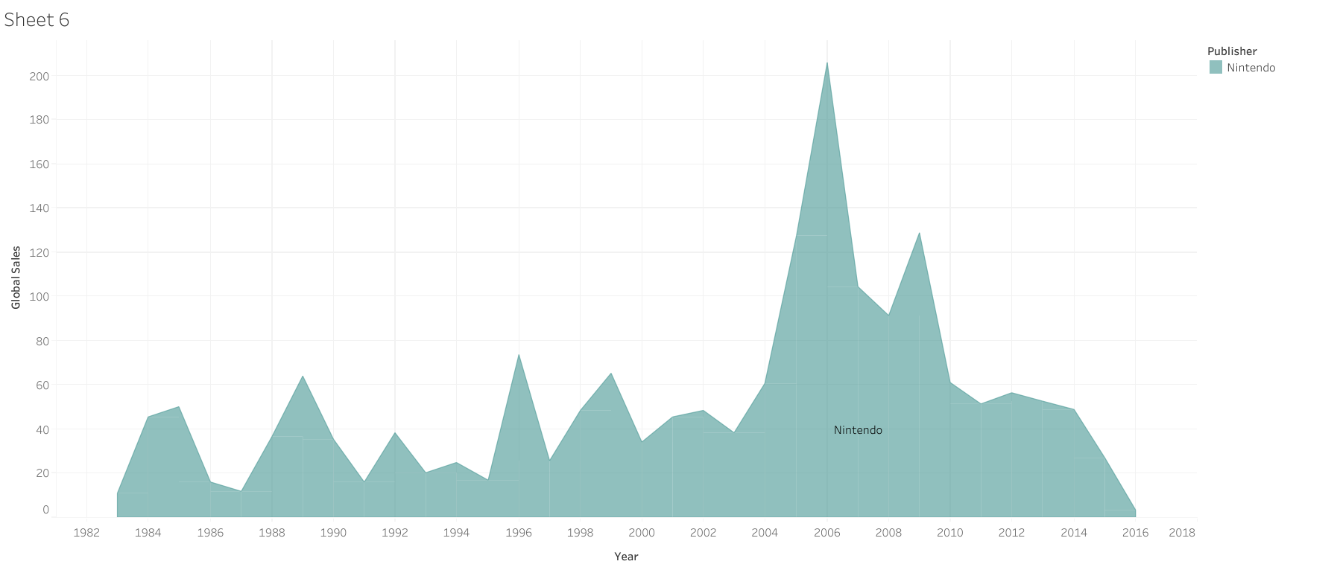
A Visual Looking at Only Games in Nintendo

Slide 9
Chart Analysis
When looking at only games released from Nintendo, it was found that the number of global sales for Nintendo video games peaked in 2006 at 205.6 million.
The lowest point of global sales for Nintendo video games was in 2016 at 3.5 million.
One can assume that over time, the popularity of Nintendo video games had some increases and drops in before peaking in 2006. Immediately after hitting its highest, global sales dropped to nearly 3.5 million in 2016, a mere fraction of the global sales made in 2006.
So, it would be wise to not put out a Nintendo game around this time, as Nintendo has lost its popularity over the years.

Slide 10
Thank You.

